Slide 1
How to talk to millions of IoT devices without pulling out your hair!
Harold Pulcher
pulcher@pulcher.biz
@haroldpulcher
https://www.youtube.com/user/hpulcher
https://github.com/pulcher/AzurePlay

Slide 2
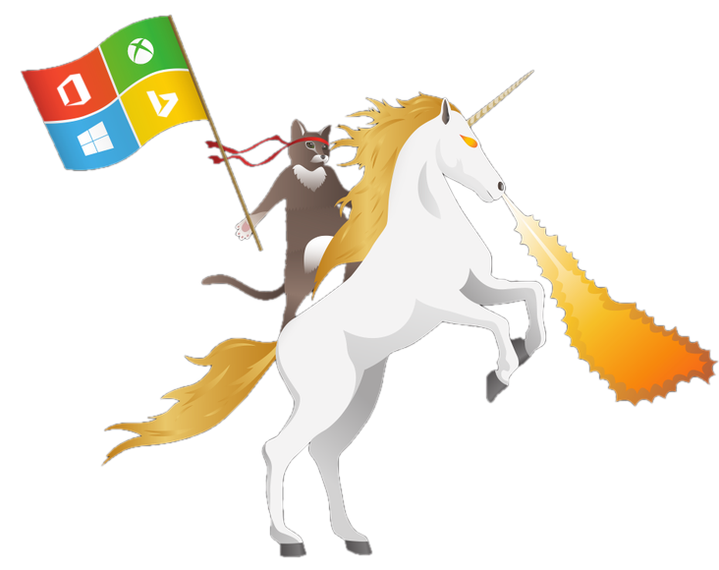
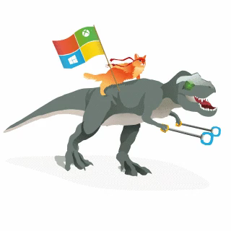
Become a Windows Insider!
https://insider.windows.com/

Slide 3

Device Challenges
Are often embedded systems with no human operator.
Can be in remote locations, where physical access is very expensive.
May have limited power and processing resources.
May have intermittent, slow, or expensive network connectivity.
May need to use proprietary, custom, or industry-specific application protocols.
Can be created using a large set of popular hardware and software platforms.

Slide 4
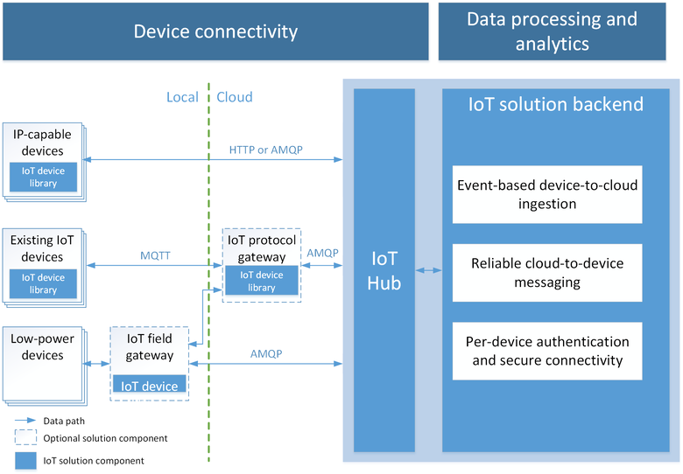
Obligatory Connection Graphic

Slide 5
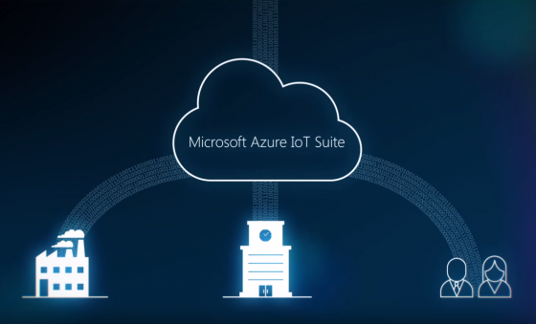
What the heck Azure IoT Suite?

Slide 6

So how do these things connect again?
AMQP
MQTT
HTTPS
Security?

Slide 7
Can I use just any old OS?
Linux:
Debian, Fedora
Raspbian, Ubuntu, Yocto
Windows:
Desktop, IoT Core,
Server, UWP
mbed OS
<your favorite os>

Slide 8
Can I use just any old language on any device?
C#
Java
Javascript
C <- The sexy isn’t dead yet!
Python
<can you talk HTTP>
Beaglebone
Minnowboard Max
Intel Edison
Raspberry Pi 0/2/3
Freescale FRDM K64
Arrow DragonBoard
Your Computer
<your favorite platform here>
https://azure.microsoft.com/en-us/develop/iot/get-started/

Slide 9
Is this gonna bankrupt me?

Slide 10
How much can I really use?

Slide 11
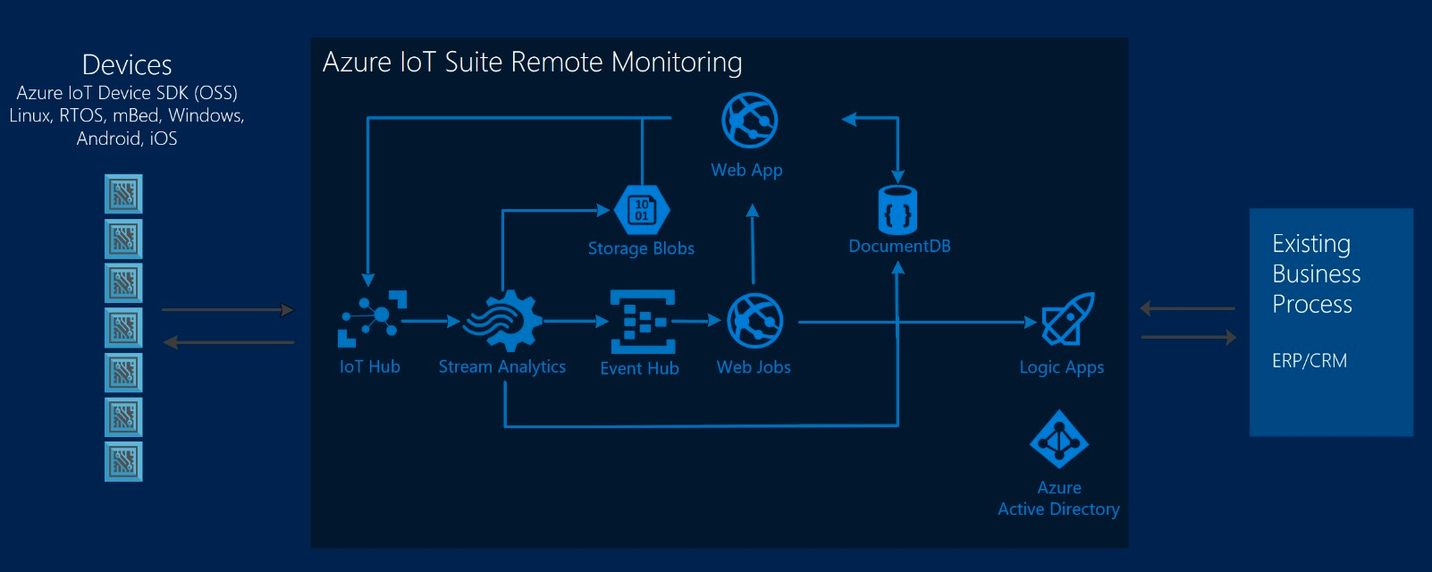
So what can I do with stuff?

Slide 12
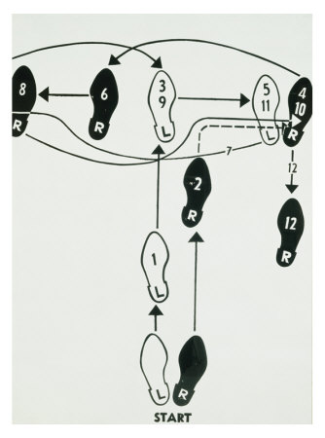
Basic Steps
Get an Azure account
Setup an IoT hub
Grab some credentials
Code up a sender, a receiver, and a device, if you have it.

Slide 13
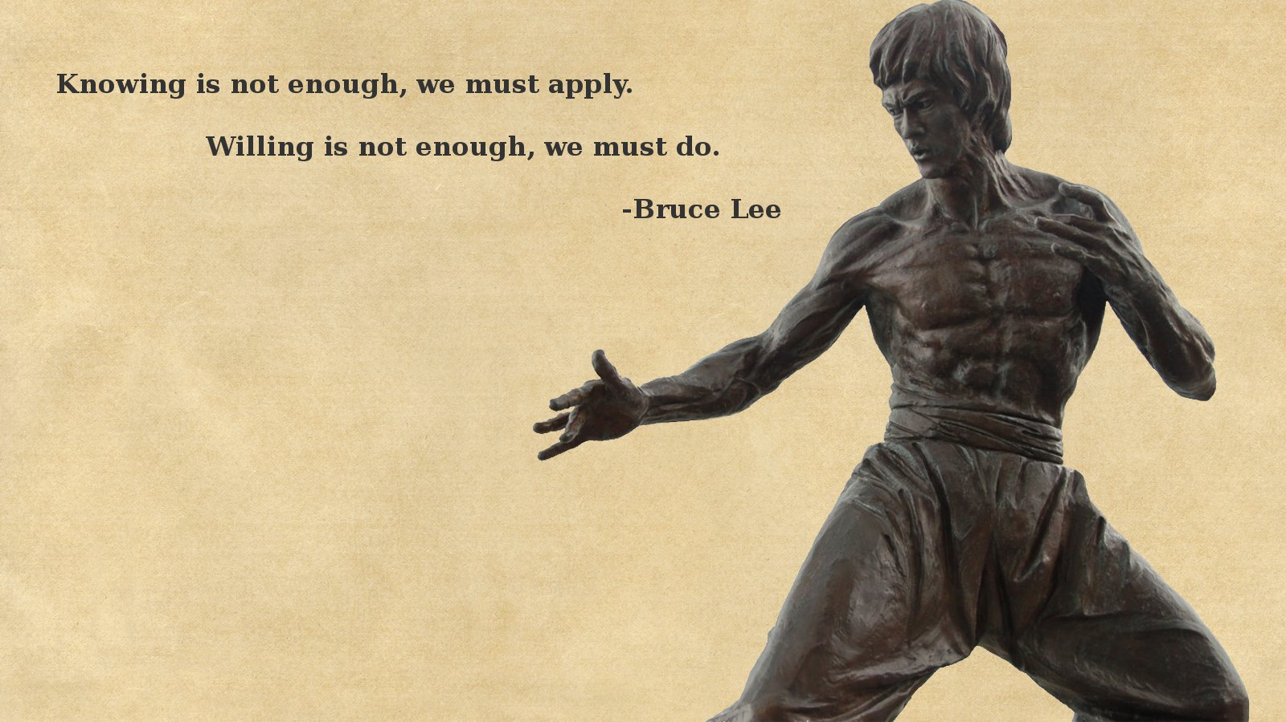
Enough! Show the goods!

Slide 14
Links
Main site: https://azure.microsoft.com/en-us/services/iot-hub/
Dev Guide: https://azure.microsoft.com/en-us/documentation/articles/iot-hub-devguide/
Azure Fridays: https://azure.microsoft.com/en-us/documentation/videos/azure-friday/
Elio Damaggio’s video: https://azure.microsoft.com/en-us/documentation/videos/azurecon-2015-overview-of-azure-iot-hub/
Oliver Bloch’s AzureCon video: https://azure.microsoft.com/en-us/documentation/videos/azurecon-2015-connect-your-iot-devices-with-azure-iot-client-libraries/
Fez Hat: https://www.ghielectronics.com/catalog/product/500

Slide 15
Device Explorer: https://github.com/Azure/azure-iot-sdk-csharp/tree/master/tools/DeviceExplorer
My examples and slides: https://github.com/pulcher/AzurePlay

